Slide 1

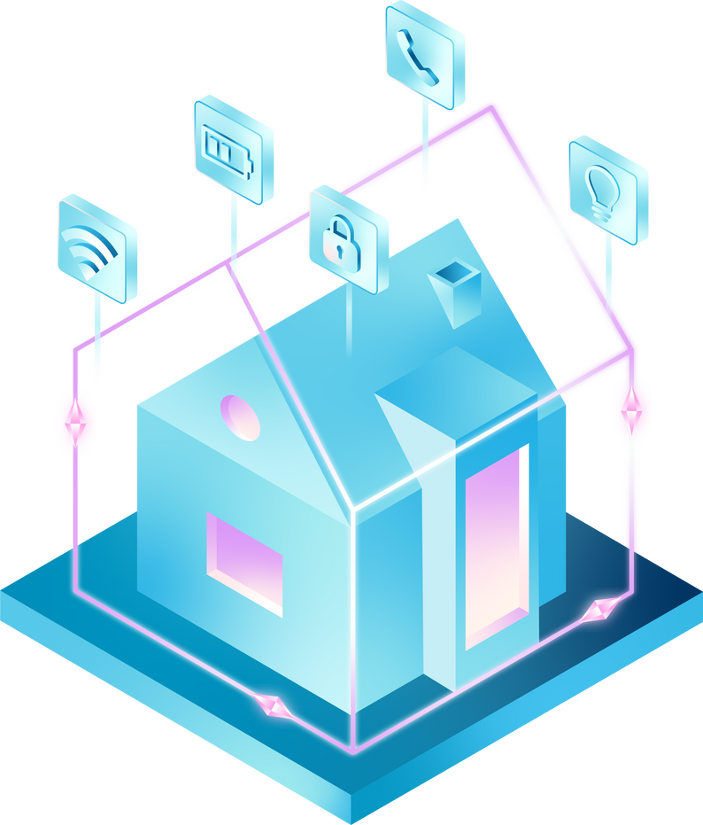
THE FUTURE OF ENERGY MANAGEMENT IS CONVERSATIONAL
A USER-CENTRIC APPROACH TOWARD POWER SCHEDULING USING LLMS
LET'S MAKE ENERGY SYSTEMS INTELLIGENT, PERSONAL, AND RESPONSIVE
📍 Hackers Agent AI Hackathon 2025
Team KU6GAI

Slide 2

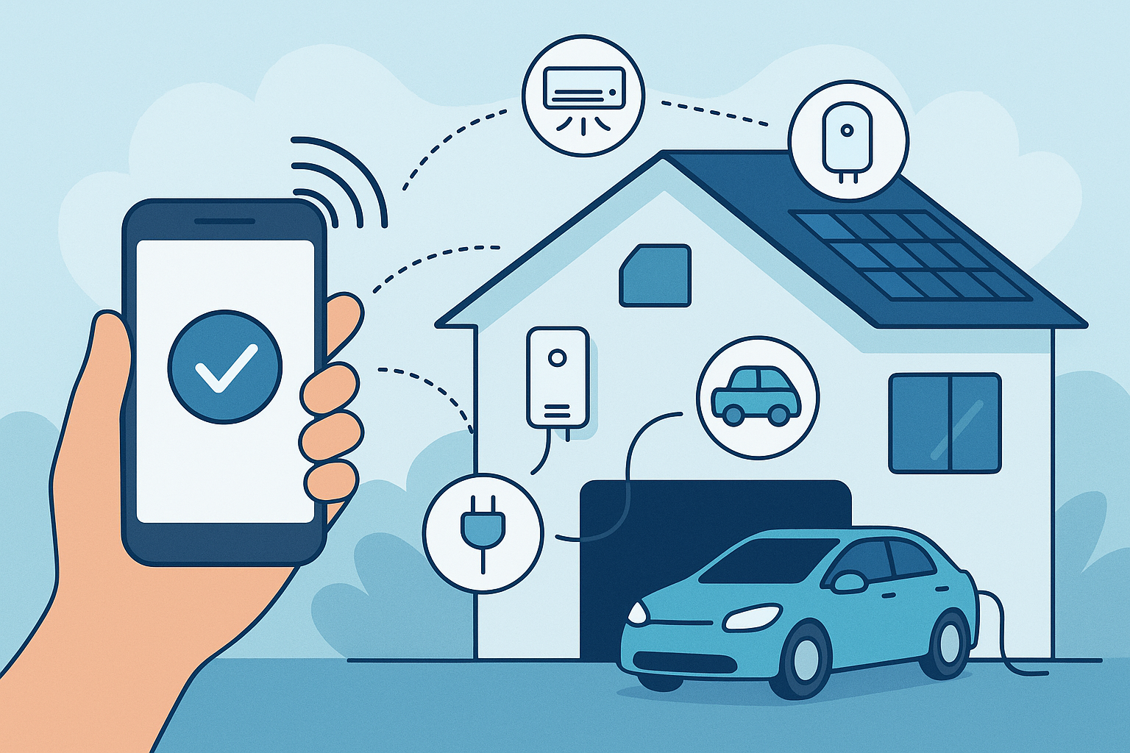


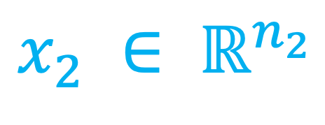
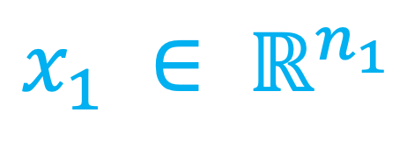

Problem: People are aware of the effects of climate change and would like to manage their home energy consumptions better but it is far too complicated
→ a lot of energy is wasted + CO2 emissions which do not bring any QoE/QoS improvements
Master Question: How can agentic LLM interpret human requests and autonomously control and coordinate all home appliances – across comfort, mobility, energy-efficiency, and sustainability?
$$x_{1} ∈ ℝ^{n_{1}}$$
I want my home to be at 23 degrees when I come back at 8 pm while minimizing the consumed energy
$$x_{2} ∈ ℝ^{n_{2}}$$
$$x_{K} ∈ ℝ^{n_{K}}$$

Slide 3
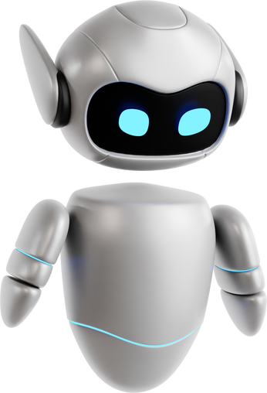
DEMO

Slide 4
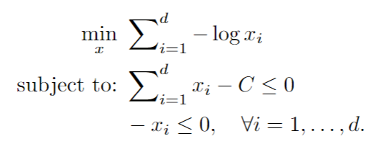
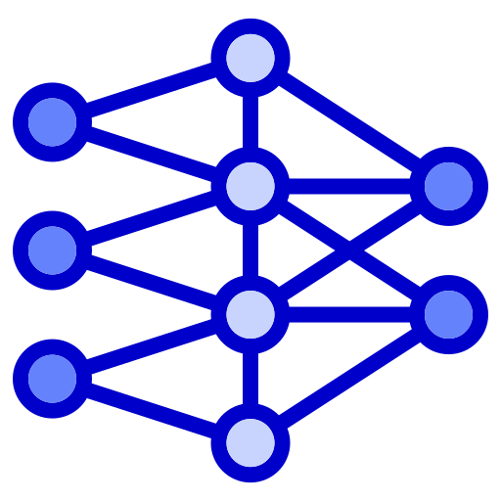
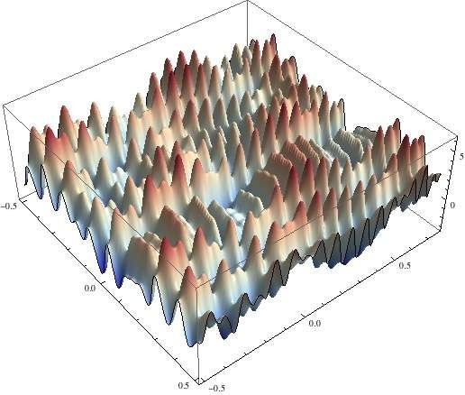
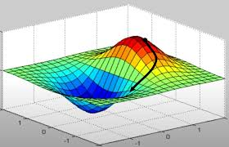
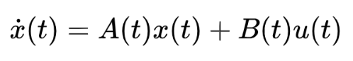
OUR PROPOSED AGENTIC AI ARCHITECTURE
Voice/text
Request
Solution
(vector)
Modeling
LLM agent
Estimation
LLM agent
Solving
LLM agent
Automatically recognize the intent and choose the most suited math model (OP, OCP, ODE, NN, …)
Automatically estimate the model parameters by exploiting all possible knowledge (request, system knowledge,Internet RAG, …)
Automatically choose the numerical solvers, tune their hyperparameters, and improve the solution cooperativeley
Quick exploration
(simulated annealing)
Visit the neighborhood with gradient
descent
4
TODAY used techniques :
hard prompting (Llama3 8B and GPT4o)
coupling with conventional solvers (SciPy, …)
curated LLM-generated synthetic test dataset (EVRQ)
TOMORROW used techniques :
home energy language fine-tuning
reinforcement learning-based reasoning
new solvers
complete pre-training for small LLMs

Slide 5

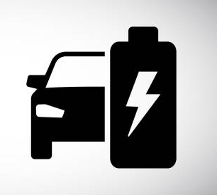





EXPECTED IMPACT
Home energy consumer: significant electricity bill reduction + less energy consumed (divided by 2-10)
EV owner: increase battery lifetime (from 200K to 400K)
Distribution system operator: increase transformer lifetime (3 billions USD market) + better network management

